Slide 1






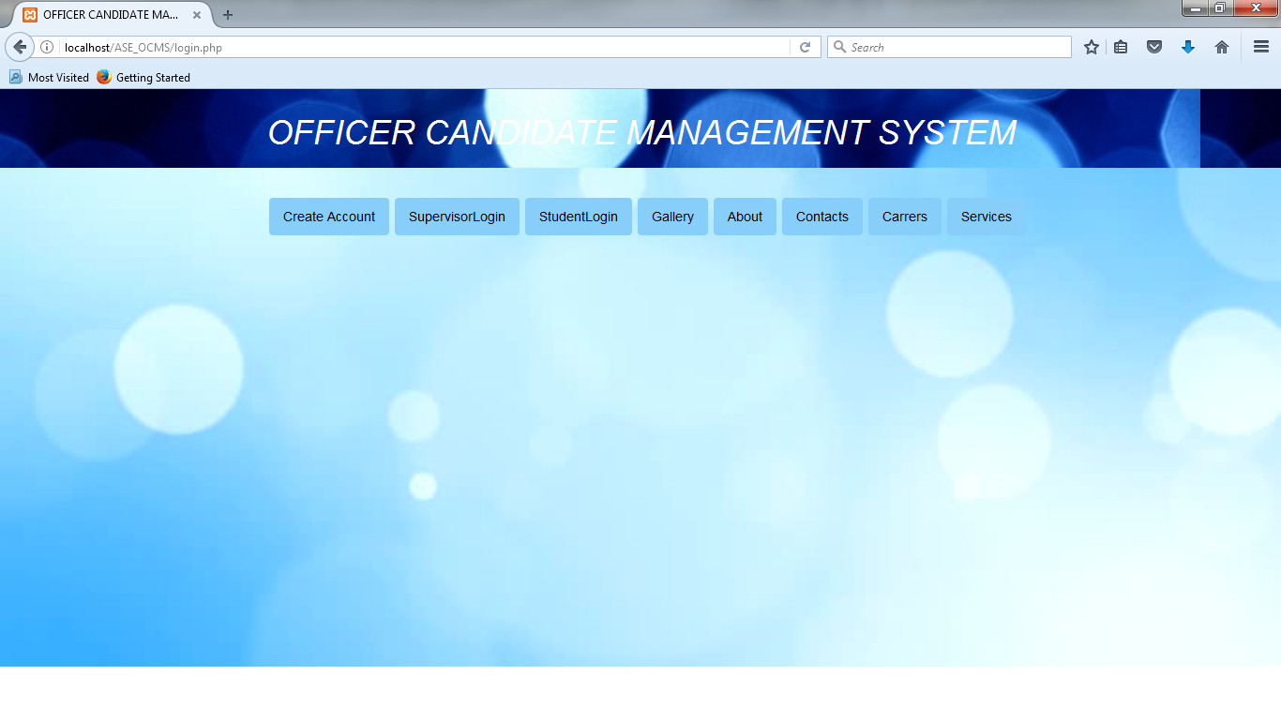
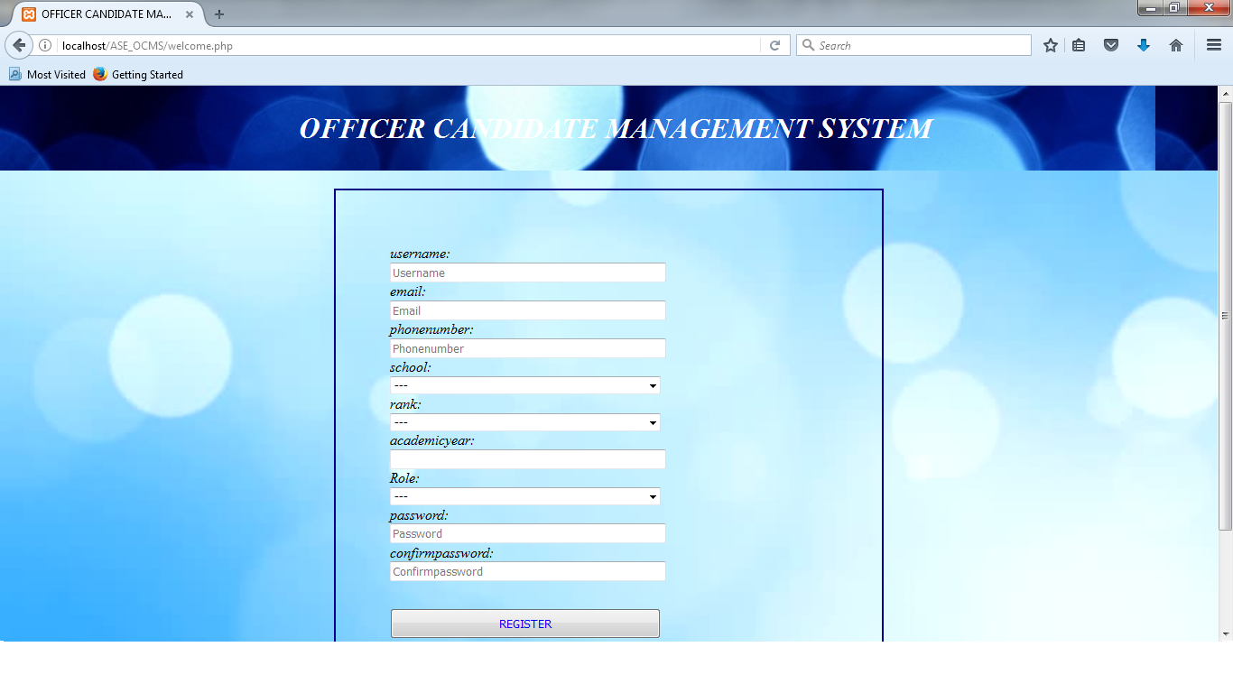
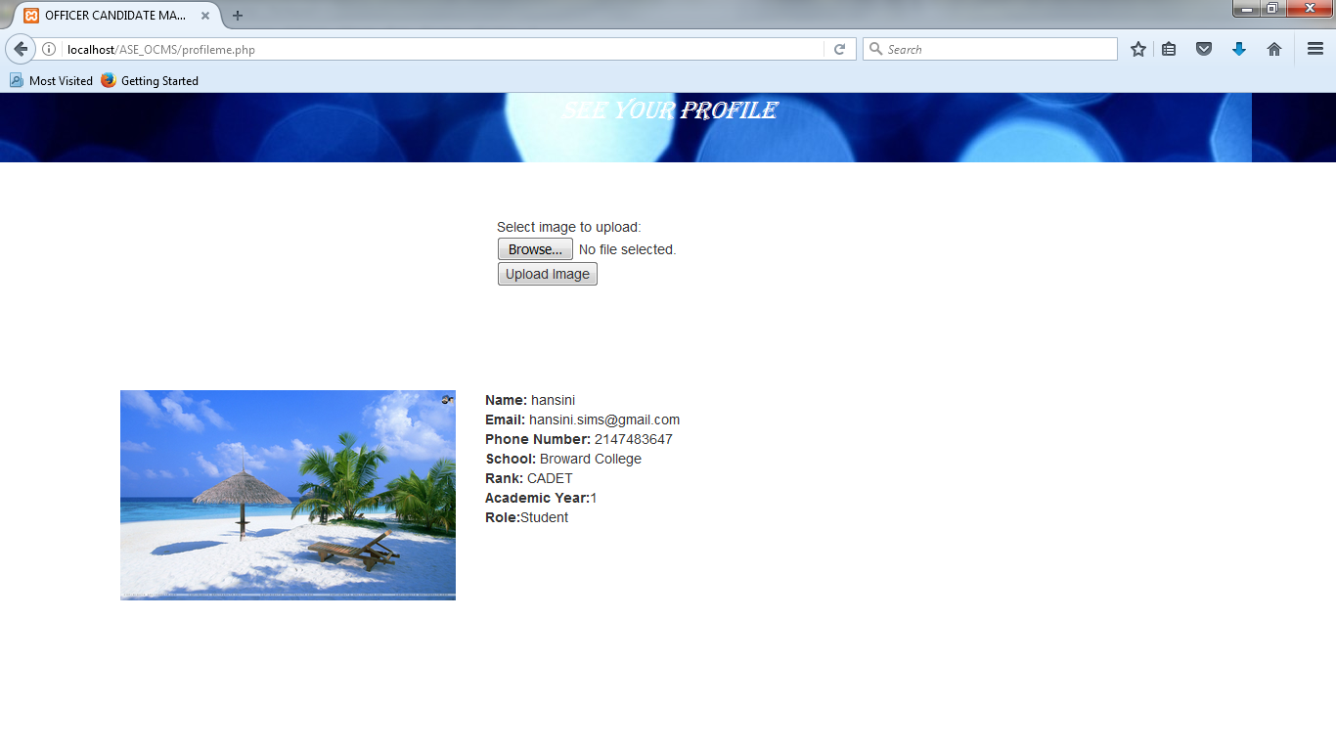
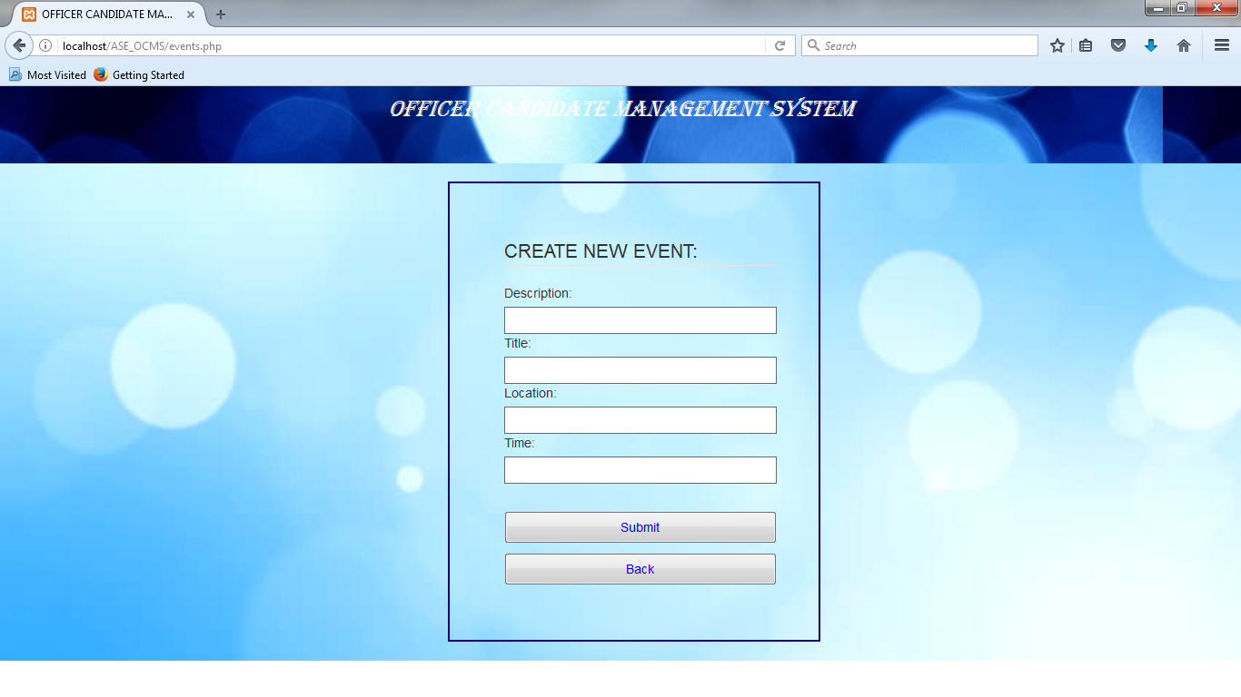
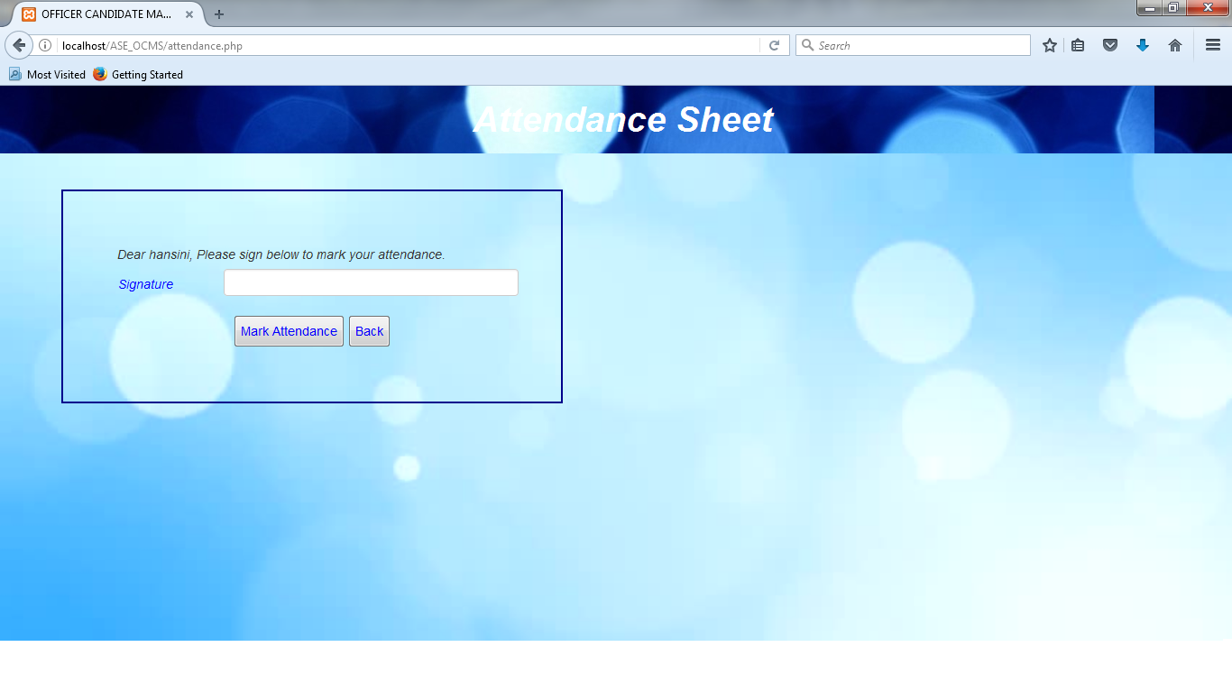
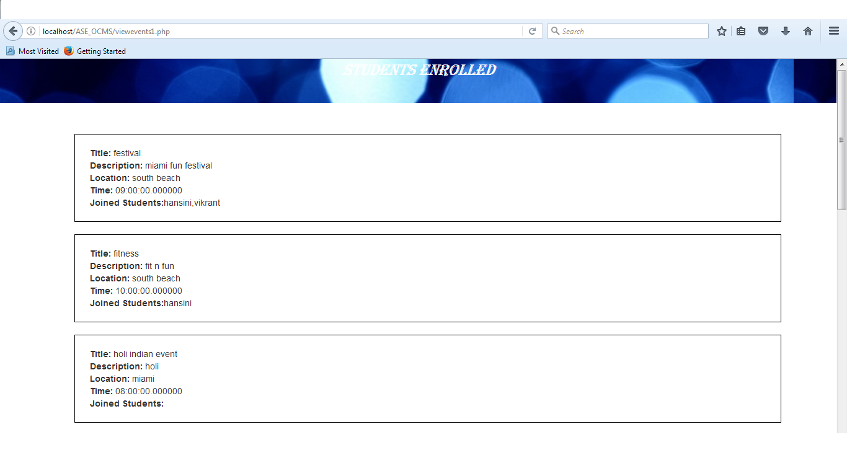
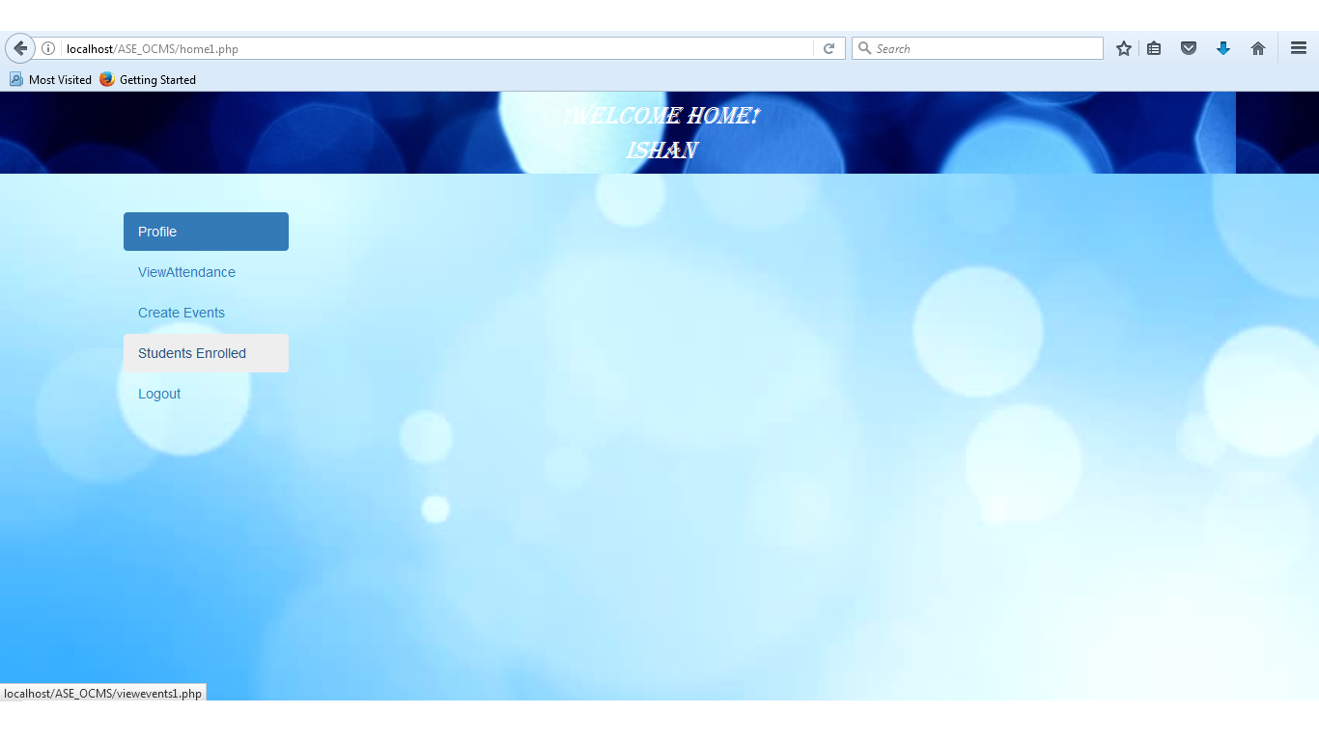
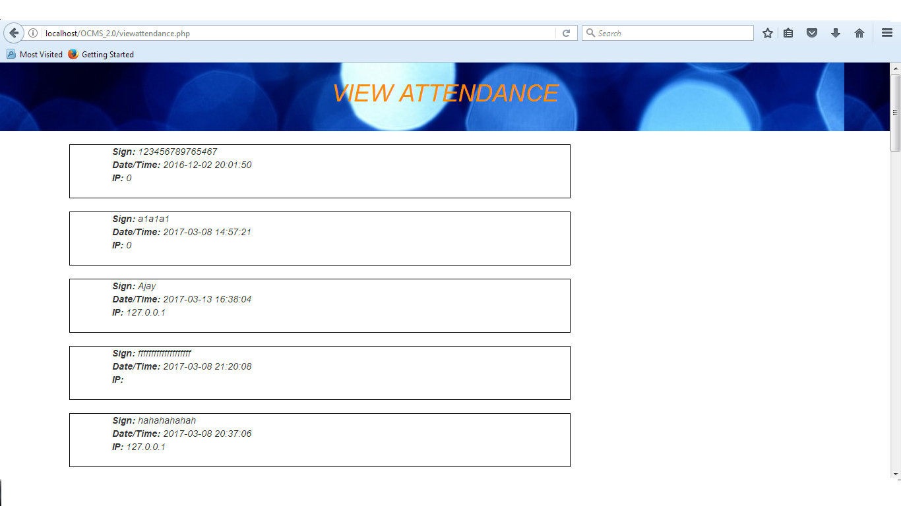

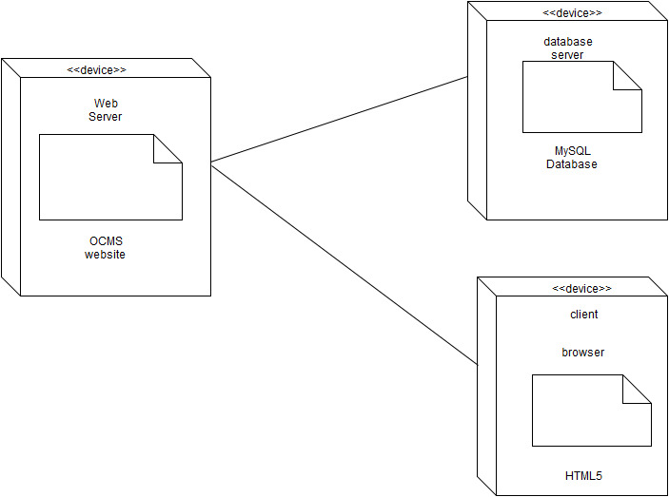
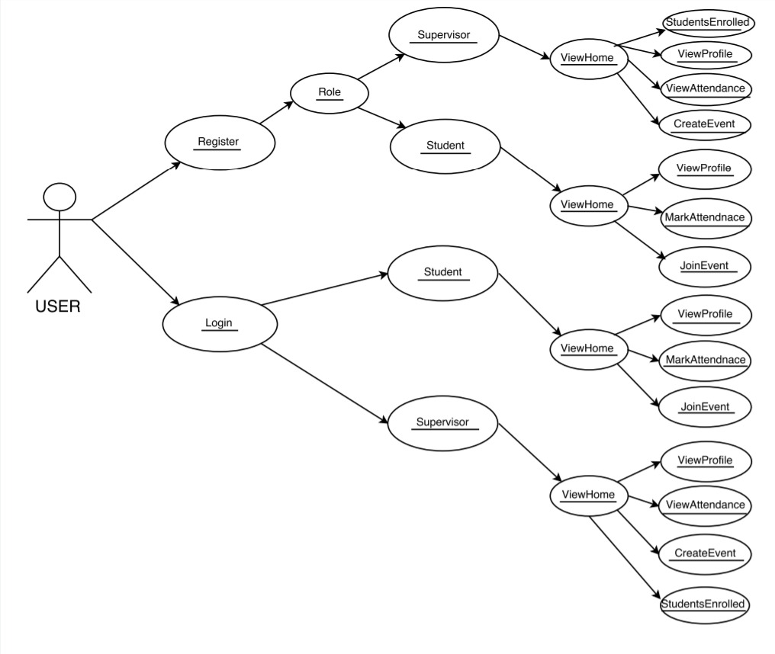

Vertically Integrated Projects, Spring 2017
Officer Candidate Management System (Version 2.0)
Student: Hansini Seth, Florida International University
Mentor: Mohsen Taheri and Tiago Moore
Instructor: Masoud Sadjadi and Francisco Ortega
Florida International University
School of Computing & Information Sciences
Problem
1. In the officers training academy, there is always a problem of managing the candidates in handling their records, attendance and shifts for training which consumes a lot of time, money and efforts.
2. Besides this there is a risk of loosing attendance sheets and the records of the candidates which can lead to duplicate data entries that results in mismanagement.
Current System
1. Supervisor and candidates are able to perform attendance and event feature.
My Tasks Include:
a. Redesigning of the application.
b. Creating Event Page for supervisor.
c. User Image
d. List of students enrolled for an event.
Solution
1. The purpose of making Officer Candidate Management System Version 2.0 is to reduce paperwork, save time and money.
2. Moreover, it can eliminate duplicate data and fake attendance entries.
3. Improves visibility to track student attendance and progress by involving them in events participation.
4. Also, the records are safely maintained without any harm.
Screenshots
Verification
Sunny Day:
1. Purpose:
To Successfully register, login, marking of attendance, creating events and joining the events.
2. Preconditions:
Each user has to first register and then login.
3. Input:
A user has to give their personal details like name, email, phone number, password etc. to register and login. 4. Expected Result:
Student can login into the account and then can give the attendance by name, date, time and IP. Also can join the listed events.
Supervisor can see the attendance by login into the account and can also create the events and see the list of students joined for the events.
Both the user can upload their profile image.
Rainy Day:
1. Purpose:
Deployment of the application on AWS server with database connection.
2. Preconditions:
User can perform all the operations of register, login, attendance, events.
3. Input:
A user has to give their personal details like name, email, phone number, password etc. to register and login.
4. Expected Result:
The application is deployed on AWS server with this URL:ocms.us-east-2.elasticbeanstalk.com
But the functionality of database is not working properly with the application showing mysqli_error.
Requirements
1. User must register to the system.
2. User must login to the system.
3. User can upload their profile picture.
4. Students can mark their presence.
5. Supervisor can view their attendance with date, time, name and IP address.
6. Supervisor can create events for students to join.
7. Students can join the events.
8. Supervisor can see the list of students who have joined the events.
Implementation
User Interface: HTML5 and CSS3
Runs on the local host: XAMPP
Coded Using:
PHP
Database Engine:
Phpmyadmin
System Design
Object Design
Summary
1. This project is the second implementation (Version 2.0)
2. The project made it possible for students to mark their attendance, register for an event.
3. The supervisor can view the attendance, create events, view joined students for the event.
4. Future work would be to use the feature through an app.
5. Email notification can be send to the user.
Acknowledgement
The material presented in this poster is based upon the work supported by Hansini Seth. I am very thankful to the help that I received from my team member Ishan Shrivastava. It was a nice experience working with him .
Notes:
1

